Slide 1
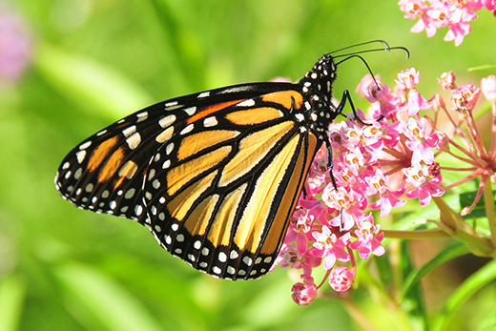




Monarchs & Milkweed
Morgan, Richard, Gwyneth + Virginie

Slide 2
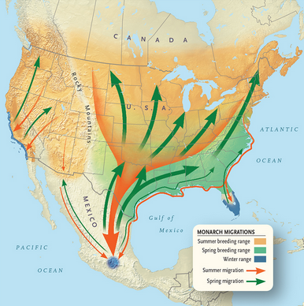

Slide 3
Method
Package spocc()
GBIF
Danaus plexippus
Asclepias
OpenRefine
BRI (Basis of Record Invalid)
Filter NA and select USA
9 Asclepias species
SQLite
In R add function for state and week of the year

Slide 4

Monarch Butterfly: Danaus plexippus Map of the USA showing the first week of butterfly occurrence over time (averaged over four-year periods) by state

Slide 5
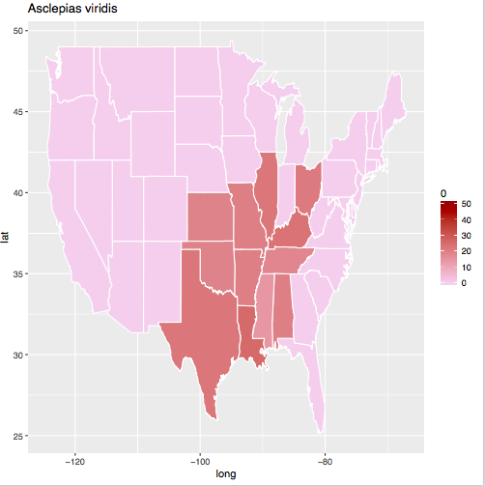

Slide 6
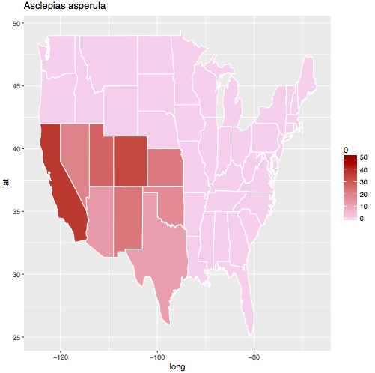

Slide 7
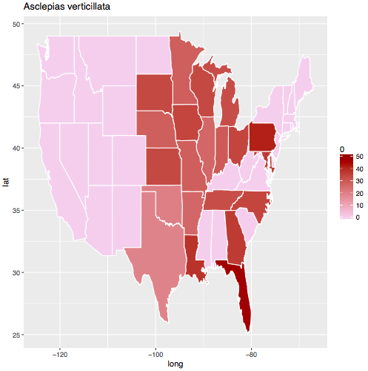

Slide 8
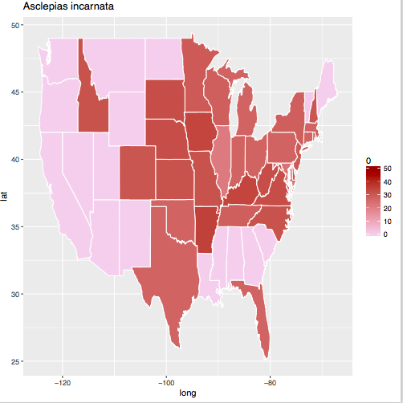

Slide 9
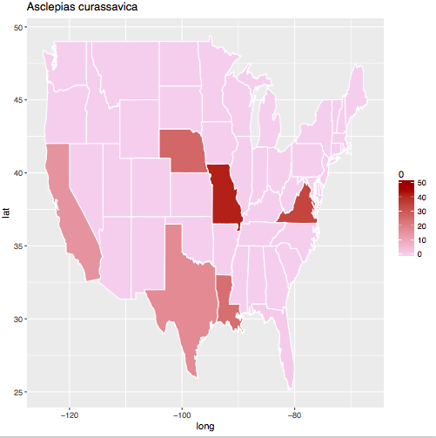

Slide 10
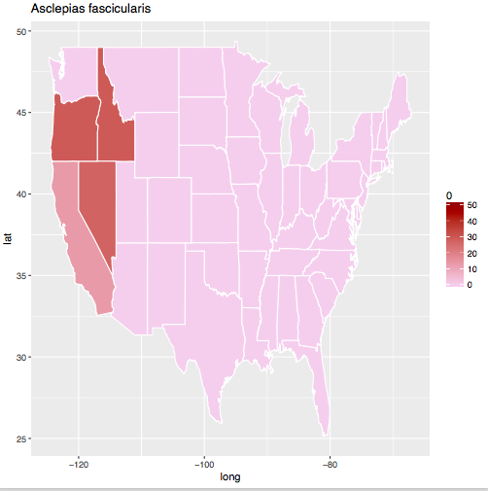

Slide 12
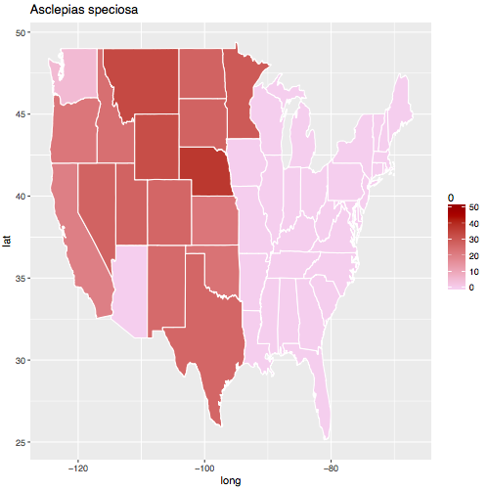

Slide 13
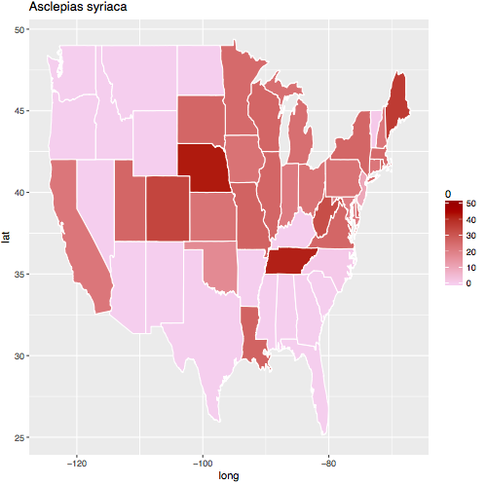

Slide 17

R² = 0.61, p < 0.001
R² = 0.75, p < 0.001
Notes:
Tuberosa

Slide 19
Notes:
Tuberosa

Slide 20
R² = 0.06, p =0.16
Notes:
speciosa

Slide 23
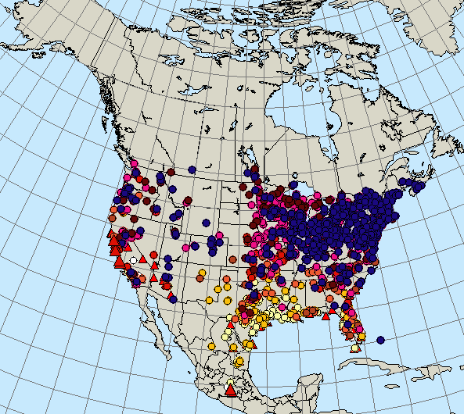
Conclusion
D. plexippus tend to stay at winter sites
Data does not allow to establish link
Sampling effort increase in recent years
Lack of data for Nothern states
Use multiple data source
Notes:
.

